Slide 1
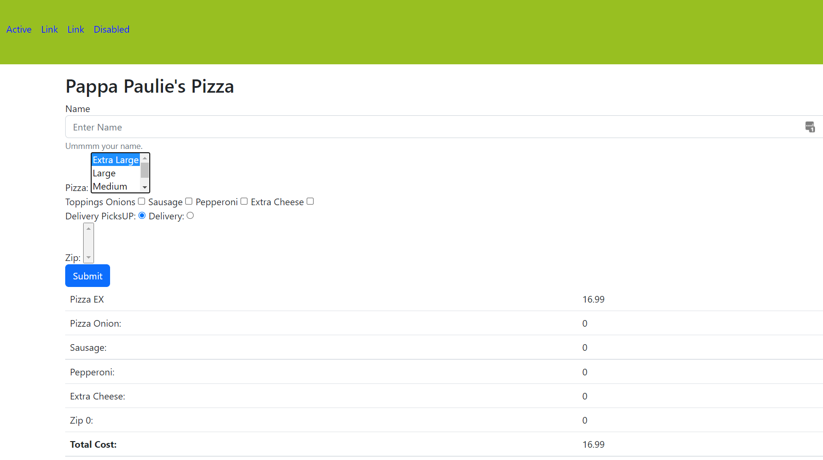
Build this site
Initially nothing is pre-selected for size
When select a size … update the price
Show all these other items as 0

Slide 2
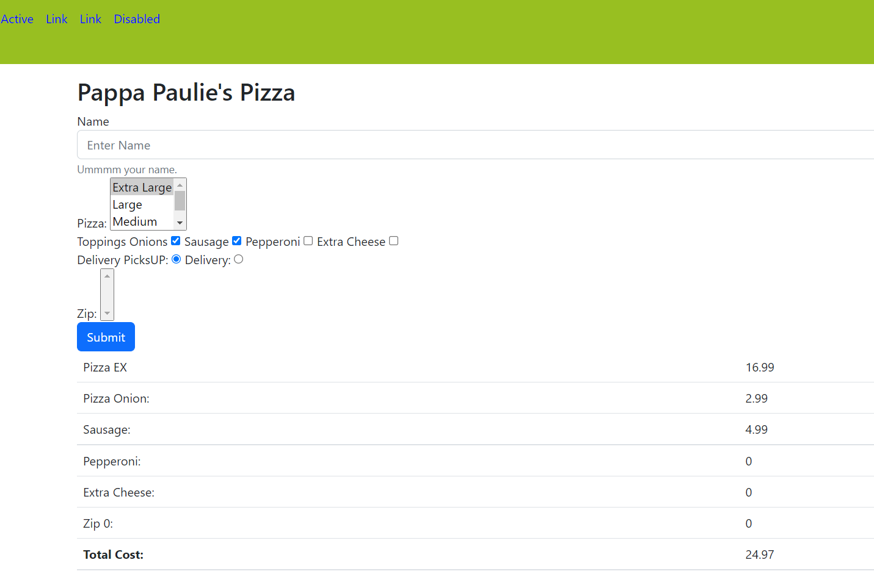
Each option you select will update the
Options area and total price
Do this onClick of each check box

Slide 3
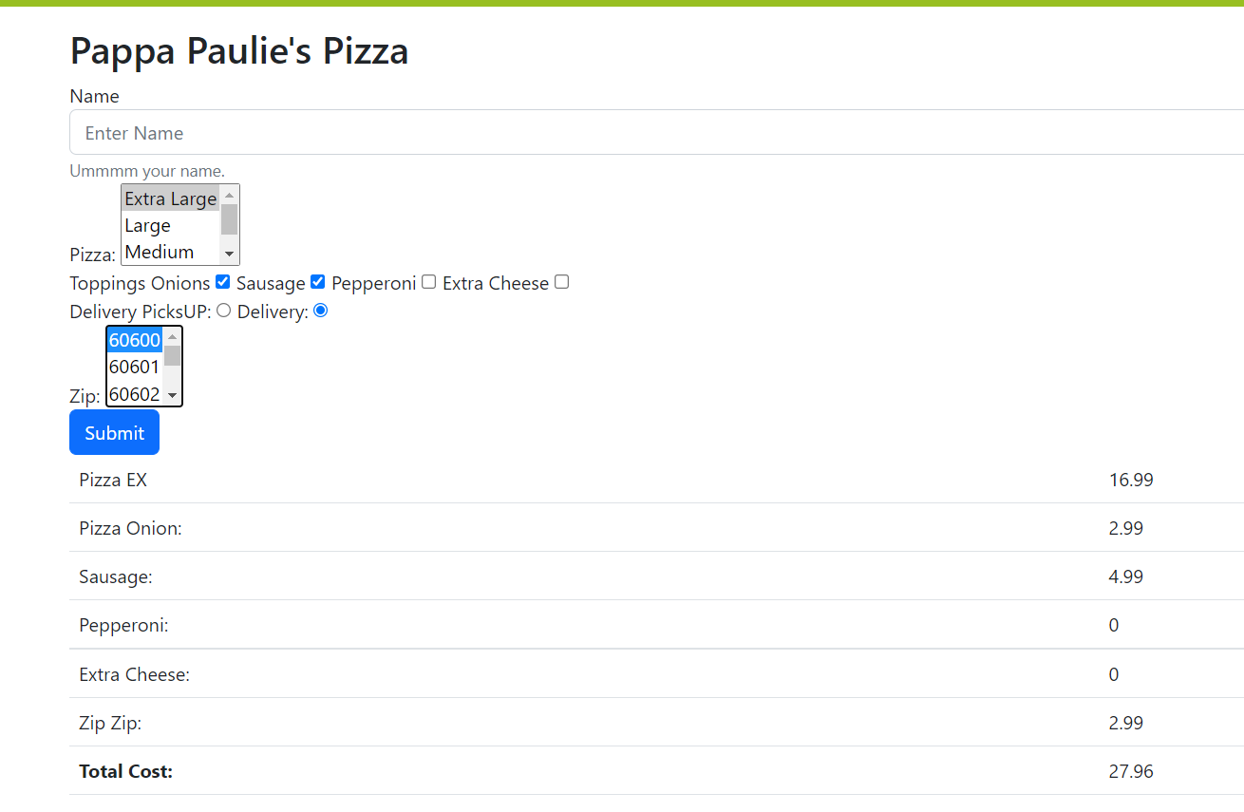
When check delivery
Populate the zip codes and alert the user to pick a zip
When select a zip code … update the costs
If the user selects pick up again … set it to 0

Slide 4
Here are some data you will need
let toppingInfo = { 'Onions' : 2.99, 'Pepperoni' : 3.99, 'Sausage' : 4.99, 'ExtraCheese' : 2.00 }; let zipInfo = [ { 'zip' : 60600, 'Cost' : 2.99}, { 'zip' : 60601, 'Cost' : 2.99}, { 'zip' : 60602, 'Cost' : 2.99}, { 'zip' : 60603, 'Cost' : 2.99}, { 'zip' : 60604, 'Cost' : 3.99}, { 'zip' : 60605, 'Cost' : 3.99}, { 'zip' : 60606, 'Cost' : 3.99}, { 'zip' : 60607, 'Cost' : 4.99}, { 'zip' : 60608, 'Cost' : 5.99}, { 'zip' : 60609, 'Cost' : 6.99} ];
let pizzaInfo = [ { 'Size' : 'Extra Large', 'Code' : 'EX', 'Cost' : 16.99}, { 'Size' : 'Large', 'Code' : 'LG', 'Cost' : 14.99}, { 'Size' : 'Medium', 'Code' : 'MD', 'Cost' : 12.99}, { 'Size' : 'SMall', 'Code' : 'Sm', 'Cost' : 10.99}, ];

Slide 5
What to hand in
Your code in a single file
The URL of it published to 45.55.136.114

